Slide 1
DERMATOLOGICAL DISEASES
Mucocutaneous diseases

Slide 2
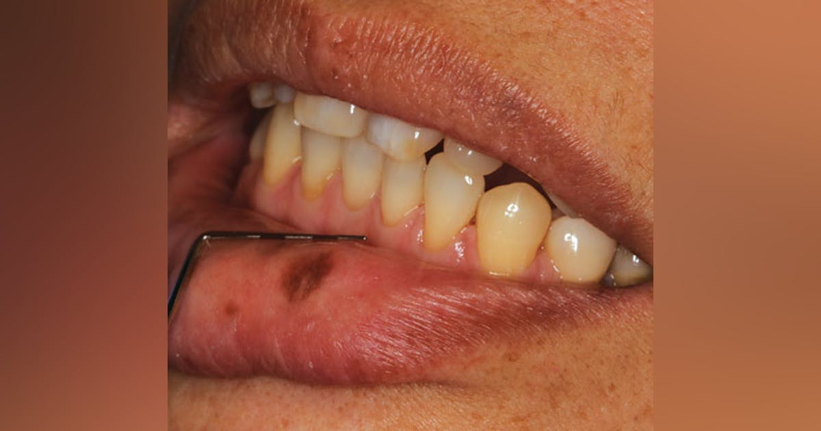
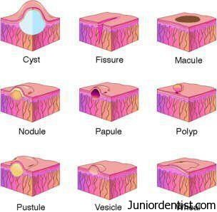
MACULE
Focal area of colour change that is not elevated or depressed in relation to its surroundings
Well Circumscribed flat lesions
Red – Inflammation
Pigmented – Melanin, hemosiderin, foreign material

Slide 3
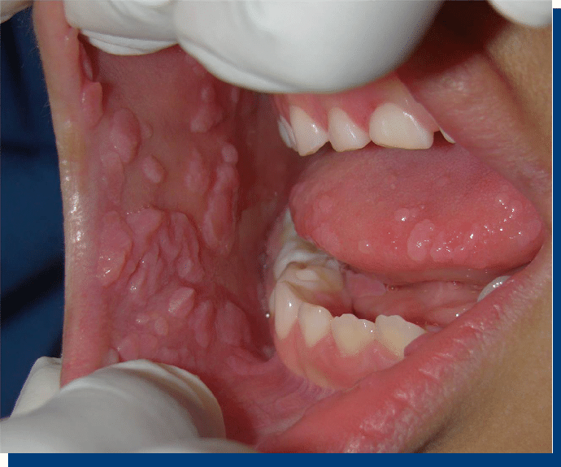
PAPULE
Solid raised lesion less than 5mm in diameter

Slide 4
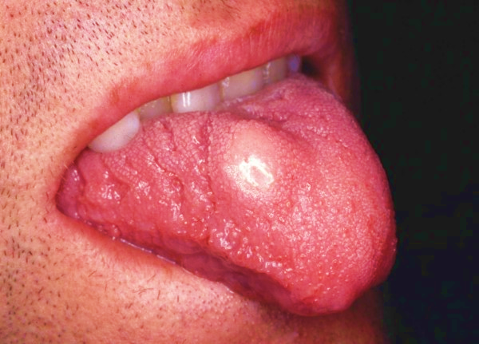
NODULE
Solid raised lesion more than 5 mm in diameter

Slide 5
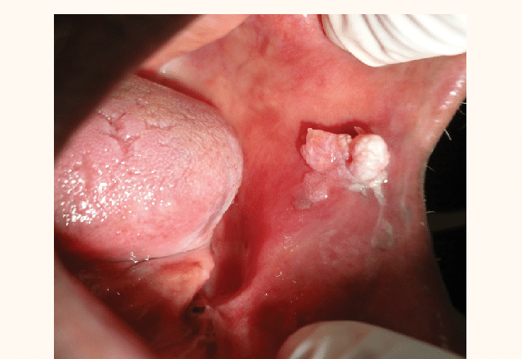
SESSILE
A tumor or growth whose base is the widest part of the lesion

Slide 6
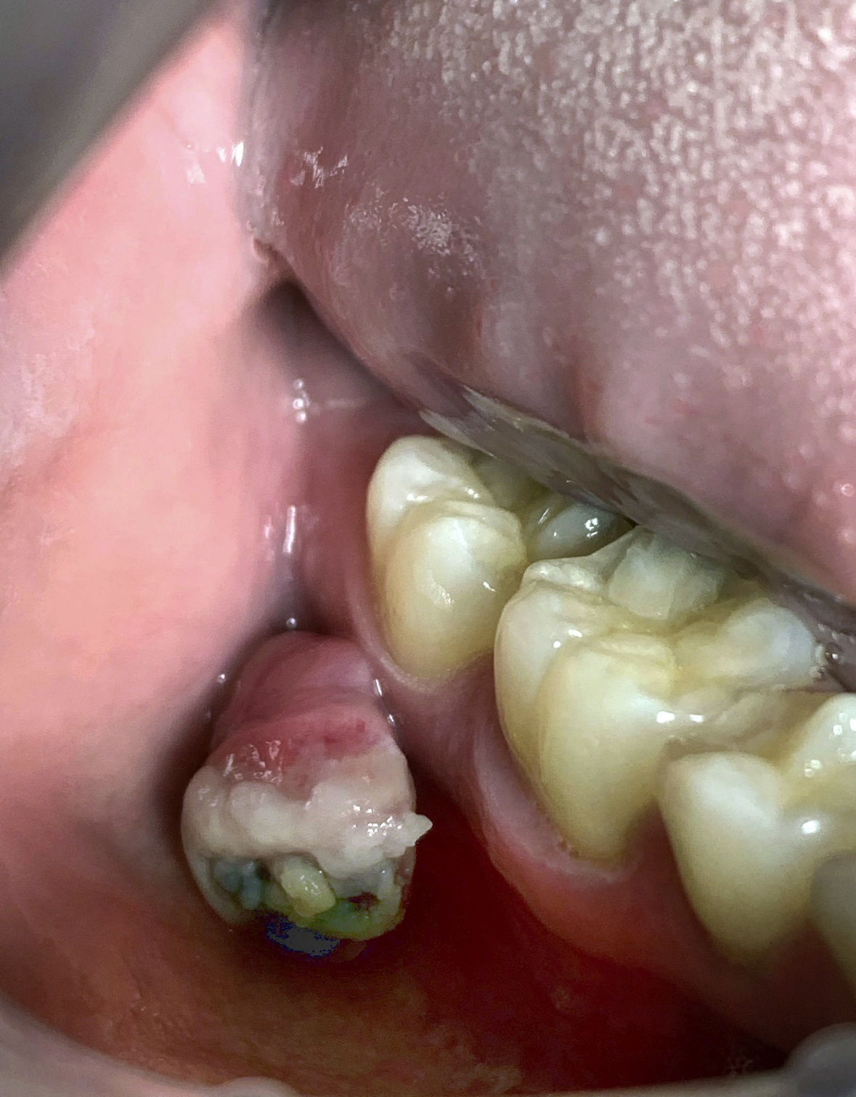
PEDUNCULATED
Tumor or growth whose base is narrower than the widest part of the lesion

Slide 7
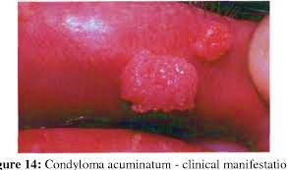
PAPILLARY
A tumor or growth exhibiting numerous surface projections

Slide 8
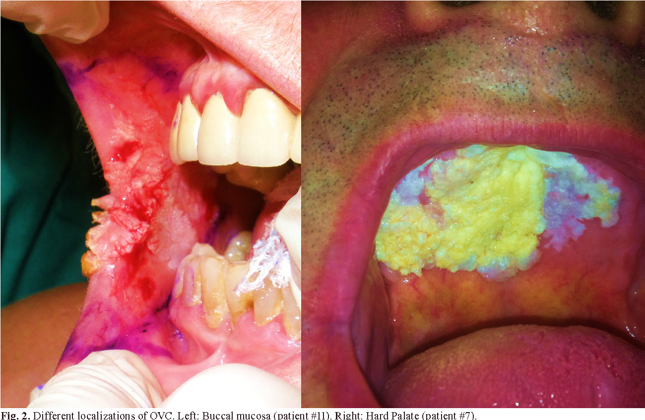
VERRUCOUS
Tumor or growth exhibiting a rough warty surface

Slide 9
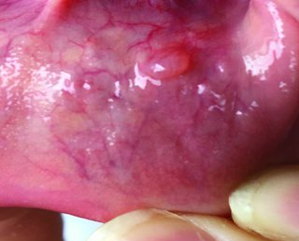
VESICLE
Superficial blister, 5 mm or less in diameter, usually filled with fluid

Slide 10
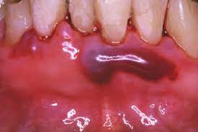
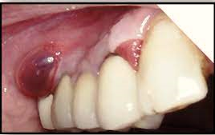
BULLA
Large blister more than 5 mm, filled with fluid

Slide 11
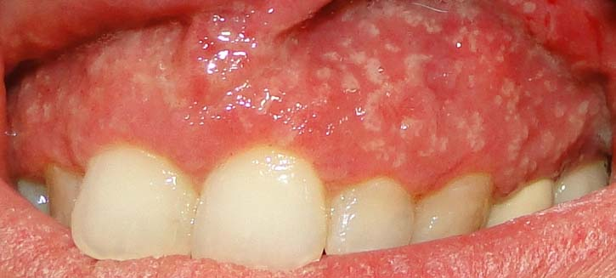
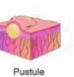
PUSTULE
Blister filled with purulent exudate

Slide 12
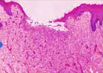
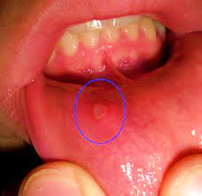
ULCER
Lesion characterized by loss of surface epithelium and frequently some of the underlying connective tissue .
Complete loss of epithelium

Slide 13
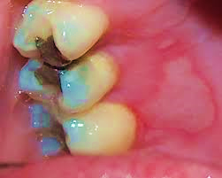
EROSION
Superficial lesion, characterized by partial loss of epithelium

Slide 14
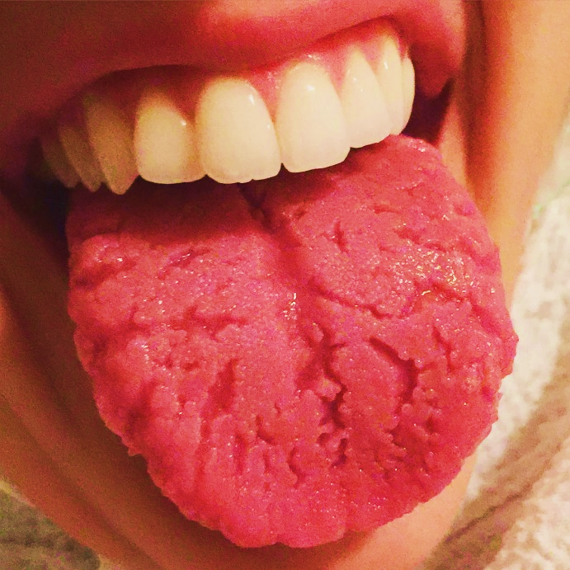
FISSURE
Narrow slit like ulceration or groove

Slide 15
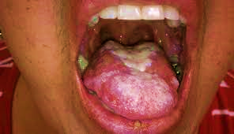
PLAQUE
Lesion that is slightly elevated and is flat on its surface

Slide 16
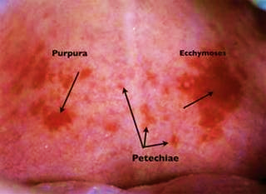
PETECHIA
Round pinpoint area of hemorrhage
Purpura - purple-colored spots and patches that occur on the skin, and in mucus membranes, including the lining of the mouth.
Ecchymosis : a discoloration of the skin resulting from bleeding underneath, typically caused by bruising.

Slide 17
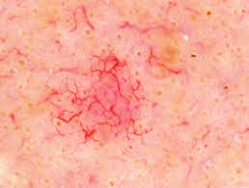
TELANIECTASIA
Vascular lesion caused by dilatation of a small superficial blood vessel

